Slide 1

Python Programming
(Business & Analytics)
by Su Lee Seng,
Jan, 2021

Slide 2

Python Programming
(Business & Analytics)
by Su Lee Seng,
Jan, 2021

Slide 3
Talk is cheap.
show me the code.

Slide 4
Python Structures
The Power of Lists

Slide 5
Python Structures - Lists :
Lists
Lists are mutable ordered containers of other objects. They support all the features of the Tuple but as they are mutable it is also possible to add elements to a List, remove elements and modify elements. The elements in the list maintain their order (until modified).

Slide 6
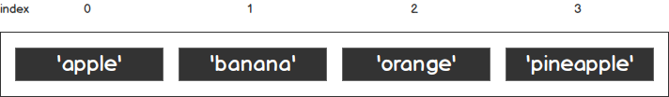
Python Structures - Lists :
Lists
A list is a type of container in Python that is used to store multiple data sets at the same time. Python lists are often compared to arrays in other programming languages, but they do a lot more.
Figure 2.2: A Python list with a positive index
fruits = [“apple",“banana", “orange“, “pineapple”]
print(fruits)

Slide 7
Python Structures - Lists :
Lists
A list in Python is written within square brackets, [ ]. Each element in the list has its own distinct position and index.
The elements in a list have a finite sequence. Like other programming languages, the index of the first item of a list is 0, and the second item has an index of 1, and so on.
This has to do with how lists are implemented at a lower programming level, so do take note of this when you are writing index-based operations for lists and other iterable objects.
<< Exercise A21 >>

Slide 8
Python Structures - Lists :
List Methods
As discussed before, since a list is a type of sequence, it supports all sequence operations and methods.
Lists are one of the best data structures to use. Python provides a set of list methods that makes it easy for us to store and retrieve values in order to maintain, update, and extract data. These common operations are what Python programmers perform, including slicing, sorting, appending, searching, inserting, and removing data.
The best way to understand this is to see them at work. You will learn about these handy list methods in the following exercises.
<< Exercise A25 >>

Slide 9
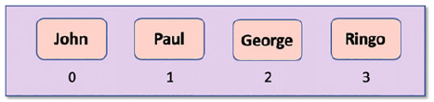
Python Structures - Lists :
Creating Lists
Lists are created using square brackets positioned around the elements that make up the List. For example:
In this case we have created a list of four elements with the first element being indexed from Zero, we thus have:
list1 = ['John', 'Paul', 'George', 'Ringo']

Slide 10
Python Structures - Lists :
Examples
Example: Create a list using the constructor of the list class
a. Create an empty list.
L1 = list();
b. Create a list with any three integer elements, such as 10, 20 and 30.
L2 = list([10,20,30])
c. Create a list with three string elements, such as “Apple”, “Banana” and “Grapes”.
L3 = list([“Apple”,”Banana”,”Grapes”])
d. Create a list using inbuilt range() function.
L4 = list(range(0,6)) # create a list with elements from 0 to 5

Slide 11
Python Structures - Lists :
Examples
Note: A list can contain the elements of mixed type.
Example:
L3=list([“John”,”Male”,25,5.8])
The above example creates a list L3, which is of mixed type, i.e. it contains elements of different types, such as string, float and integer.

Slide 12
Python Structures - Lists :
Examples
e. Create a list with inbuilt characters X, Y and Z.
L5=list(“xyz”)
Example: Creating a list without using the constructor of the list class
a. Create a list with any three integer elements, such as 10, 20 and 30.
L1=[10,20,30]
b. Create a list with three string elements, such as “Apple”, “Banana” and “Grapes”.
L2 = [“Apple”, “Banana”, “Grapes”]
Note: A list can contain the elements of mixed type.
Example:
L3=list([“Jhon”,”Male”,25,5.8])
The above example creates a list L3, which is of mixed type, i.e. it contains elements of different types,
such as string, float and integer.
<< Exercise A27 >>

Slide 13
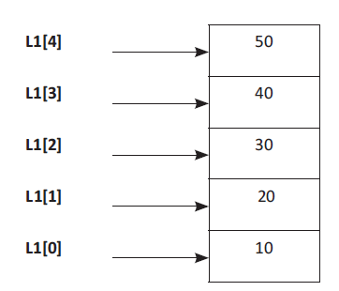
Python Structures - Lists :
Accessing an Item from a List
>>> L1=([10,20,30,40,50]) #Create a List with 5 Different Elements
>>> L1 #print the complete List
[10, 20, 30, 40, 50]
>>> L1[0]
10
<< Exercise A26 >>

Slide 14
Python Structures - Lists :
Accessing an Item from a List
Just like other programming languages, in Python, you can use the indexer method to access elements in a list.
shopping = ["bread","milk", "eggs"]
print(shopping[1])
You should get the following output:
milk

Slide 15
Python Structures - Lists :
Adding an Item to a List
Lists are very powerful and are widely used in many circumstances. However, you often won't know the data your users want to store beforehand, but only after the program is running. Here, you are going to look at various methods for adding items to and inserting items into a list.

Slide 16
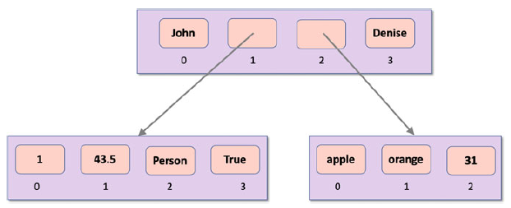
Python Structures - Lists :
Nested Lists
As with Tuples we can have nested lists and lists containing different types of elements.

Slide 17
Python Structures - Lists :
Nested Lists
In code this can be defined as:
l1 = [1, 43.5, Person('Phoebe', 21), True]
l2 = ['apple', 'orange', 31]
root_list = ['John', l1, l2, 'Denise']
print(root_list)
Output :
['John', [1, 43.5, <tuples.Person object at 0x1042ba4a8>,
True], ['apple', 'orange', 31], 'Denise']
Notes:
Note the square brackets inside the outer square brackets indicating nested lists.

Slide 18
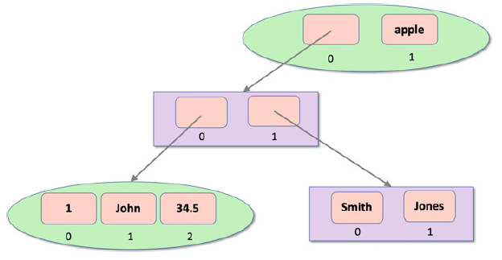
Python Structures - Lists :
Nested Lists
We can of course also nest Tuples in lists and lists in Tuples. For example, the following structure shows Tuples (the ovals) hold references to Lists (the rectangles) and vice versa:

Slide 19
Python Structures - Lists :
Nested Lists
In code this would look like:
t1 = (1, 'John', 34.5)
l1 = ['Smith', 'Jones']
l2 = [t1, l1]
t2 = (l2, 'apple')
print(t2)
Output :
([(1, 'John', 34.5), ['Smith', 'Jones']], 'apple')

Slide 20
Python Structures - Lists :
List Constructor Function
The list() function can be used to construct a list from an iterable; this means that it can construct a list from a Tuple, a Dictionary or a Set. It can also construct a list from anything that implements the iterable protocol. The signature of the list() function is
list(iterable)
For example :
vowelTuple = ('a', 'e', 'i', 'o', 'u')
print(list(vowelTuple))
Output :
['a', 'e', 'i', 'o', 'u']

Slide 21
Python Structures - Lists :
Accessing Elements from a List
list1 = ['John', 'Paul', 'George', 'Ringo']
print(list1[1])
This will print out the element at index 1 which is Paul (lists are indexed from Zero so the first element is the zeroth element).
If you use a negative index such as −1 then the index is reversed so an index of −1 starts from the end of the list (−1 returns the last element, −2 the second to last etc.).

Slide 22
Python Structures - Lists :
Accessing Elements from a List
It is also possible to extract a slice (or sublist) from a list. This is done by providing a starting and end index to within the square brackets separated by a colon.
For example [1:4] indicates a slice starting at the one-th element and extending up to (but not including) the fourth element. If either of the indexes is missed for a slice then that indicates the start or end of the list respective.
list1 = ['John', 'Paul', 'George', 'Ringo']
print('list1[1]:', list1[1])
print('list1[-1]:', list1[-1])
print('list1[1:3]:', list1[1:3])
print('list[:3]:', list1[:3])
print('list[1:]:', list1[1:])
Output :
list1[1]: Paul
list1[-1]: Ringo
list1[1:3]: ['Paul', 'George']
list[:3]: ['John', 'Paul', 'George']
list[1:]: ['Paul', 'George', 'Ringo']

Slide 23
Lists
List Methods

Slide 24
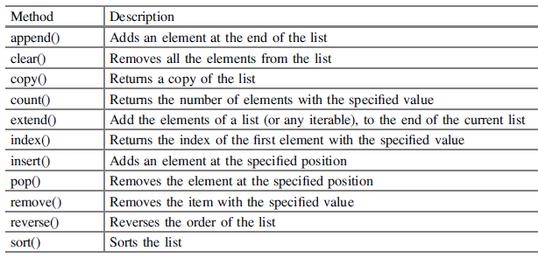
Python Structures - Lists :
List Methods
Python has a set of built-in methods that you can use on lists.

Slide 25
Python Structures - Lists :
List Methods
>>> List1=[‘X’,’Y’,’Z’]
>>> List1
[‘X’, ‘Y’, ‘Z’]
>>> List1.append(‘A’) #Append element ‘A’ to the end of the List1
>>> List1
[‘X’, ‘Y’, ‘Z’, ‘A’]

Slide 26
Python Structures - Lists :
List Methods
Note: Append method is equivalent to doing:
List1[len(List1):]=[Element_Name]
>>>List1=[“Red”,”Blue”,”Pink”]
>>> List1
[‘Red’, ‘Blue’, ‘Pink’]
>>> List1[len(List1):]=[‘Yellow’]
>>> List1
[‘Red’, ‘Blue’, ‘Pink’, ‘Yellow’]

Slide 27
Python Structures - Lists :
List Methods
>>> List1=[“Red”, “Blue”, “Pink”]
>>> List1
[‘Red’, ‘Blue’, ‘Pink’]
>>> List1.clear() # Removes all the element of List
>>> List1 # Returns Empty List after removing all elements
[]
>>> List1=[‘A’,’B’,’C’,’A’,’B’,’Z’]
>>> List1
[‘A’, ‘B’, ‘C’, ‘A’, ‘B’, ‘Z’]
#Count the number of times the element ‘A’ has appeared in the list

Slide 28
Python Structures - Lists :
List Methods
>>> List1.count(‘A’)
2 # Thus, ‘A’ has appeared 2 times in List1
>>> List1=[“Red”,”Blue”,”Pink”]
>>> List1
[‘Red’, ‘Blue’, ‘Pink’]
>>> List2=List1.copy() # Copy the contents of List1
to List2
>>> List2
[‘Red’, ‘Blue’, ‘Pink’]

Slide 29
Python Structures - Lists :
List Methods
>>> List1=[“Red”,”Blue”,”Pink”]
>>> List2=List1[:]
>>> List2
[‘Red’, ‘Blue’, ‘Pink’]
>>> List1= [1,2,3]
>>> List2= [4,5,6]
>>> List1
[1, 2, 3]
>>> List2
[4, 5, 6]

Slide 30
Python Structures - Lists :
List Methods
>>> List1.extend(List2) #Appends all the elements of List2 to List1
>>> List1
[1, 2, 3, 4, 5, 6]
>>> List1=[‘A’,’B’,’C’,’B’,’D’,’A’]
>>> List1
[‘A’, ‘B’, ‘C’, ‘B’, ‘D’, ‘A’]
>>> List1.index(‘B’)
1 #Returns the index of element B

Slide 31
Python Structures - Lists :
List Methods
>>> Lis1=[10,20,30,40,60]
>>> Lis1
[10, 20, 30, 40, 60]
>>> Lis1.insert(4,50) #Insert Element 50 at index 4
>>> Lis1
[10, 20, 30, 40, 50, 60]
>>> Lis1=[10,20,30,40,60]
>>> Lis1
[10, 20, 30, 40, 60]
>>> Lis1.pop(1) # Remove the element which is at index 1.
20

Slide 32
Python Structures - Lists :
List Methods
>>> Lis1 # Display List after removing the element from index 1.
[10, 30, 40, 60]
>>> Lis1.pop() # Remove the last element from the list
60
>>> Lis1
[10, 30, 40] #Display the list after removing last element

Slide 33
Python Structures - Lists :
List Methods – List deletion
>>> names . remove (’Paul ’)
>>> print names
[’George ’, ’Henry ’, ’Fred ’]
As with many of the other operations on lists, you can also delete by index using the bracket notation:
>>> del names [1]
>>> print names
[’George ’, ’Fred ’]

Slide 34
Python Structures - Lists :
List Methods
>>> List1=[‘A’,’B’,’C’,’B’,’D’,’E’]
>>> List1
[‘A’, ‘B’, ‘C’, ‘B’, ‘D’, ‘E’]
>>> List1.remove(‘B’)#Removes the first occurrence of element B
>>> List1
[‘A’, ‘C’, ‘B’, ‘D’, ‘E’]
>>> List1=[‘A’,’B’,’C’,’B’,’D’,’E’]
>>> List1
[‘A’, ‘B’, ‘C’, ‘B’, ‘D’, ‘E’]

Slide 35
Python Structures - Lists :
List Methods
>>> List1.reverse() # Reverse all the elements of the list.
>>> List1
[‘E’, ‘D’, ‘B’, ‘C’, ‘B’, ‘A’]
>>> List1=[‘G’,’F’,’A’,’C’,’B’]
>>> List1
[‘G’, ‘F’, ‘A’, ‘C’, ‘B’] #Unsorted List
>>> List1.sort()
>>> List1 #Sorted List
[‘A’, ‘B’, ‘C’, ‘F’, ‘G’]

Slide 36
Python Structures - Lists :
List Methods – List sorting
>>> names . sort ()
>>> print names
[’Fred ’, ’George ’]
If the previous order of the list was important, you can make a copy of it before sorting. Another option is to use the sorted function. sorted creates a new list that is reordered:
>>> old = [5, 3, -2, 1]
>>> nums_sorted = sorted (old)
>>> print nums_sorted
[-2, 1, 3, 5]
>>> print old
[5, 3, -2, 1]

Slide 37
Python Structures - Lists :
List Methods – List sorting
>>> things = [2, ’abc ’, ’Zebra ’, ’1’]
>>> things . sort ()
>>> print things
[2, ’1’, ’Zebra ’, ’abc ’]
Both the sort method and sorted function allow arbitrary control of sorting by passing in a function for the key parameter. In this example, by passing in str as the key parameter, every item in the list is sorted as if it were a string:
>>> things . sort (key= str)
>>> print things
[’1’, 2, ’Zebra ’, ’abc ’]

Slide 38
Python Structures - Lists :
List Methods
my_list = [‘two’, 5, [‘one’, 2]]
print(len(my_list))
3
Mixed_List=[‘pet’ , ‘dog’ ,5, ‘cat’, ‘good’,’dog’]
Mixed_List.count(‘dog’)
2
Explanation It returns the number of occurrence of “dog” in the list.

Slide 39
Python Structures - Lists :
List Methods
Mylist=[‘Red’,3]
Mylist.extend(‘Green’)
print(Mylist)
[‘Red’, 3, ‘G’, ‘r’, ‘e’, ‘e’, ‘n’]
Explanation Extend the list by adding each character to it.
Mylist=[3,’Roses’,2,’ Chocolate ‘]
Mylist.remove(3)
Mylist
[‘Roses’, 2, ‘Chocolate’]
Explanation Remove the item from the list whose value is 3.

Slide 40
Python Structures - Lists :
Adding to a List
You can add an item to a list using the append() method of the List class (this changes the actual list; it does not create a copy of the list). The syntax of this method is:
<alist>.append(<object>)
As an example, consider the following list of strings, to which we append a fifth string:
list1 = ['John', 'Paul', 'George', 'Ringo']
list1.append('Pete')
print(list1)
Output :
['John', 'Paul', 'George', 'Ringo', 'Pete']

Slide 41
Python Structures - Lists :
Adding to a List
You can also add all the items in a list to another list. There are several options here, we can use the extend() method which will add the items passed to it to the end of the list or we can use the += operator which does the same thing:
list1 = ['John', 'Paul', 'George', 'Ringo', 'Pete']
print(list1)
list1.extend(['Albert', 'Bob'])
print(list1)
list1 += ['Ginger', 'Sporty']
print(list1)
Output :
['John', 'Paul', 'George', 'Ringo', 'Pete']
['John', 'Paul', 'George', 'Ringo', 'Pete', 'Albert', 'Bob']
['John', 'Paul', 'George', 'Ringo', 'Pete', 'Albert', 'Bob',
'Ginger', 'Sporty']
Notes:
Which approach you prefer to use is up to you.
Note that strictly speaking both extend() and += take an iterable.

Slide 42
Python Structures - Lists :
Inserting into a List
You can also insert elements into an existing list. This is done using the insert() method of the List class. The syntax of this method is:
<list>.insert(<index>, <object>)
The insert() method takes an index indicating where to insert the element and an object to be inserted.

Slide 43
Python Structures - Lists :
Inserting into a List
a_list = ['Adele', 'Madonna', 'Cher']
print(a_list)
a_list.insert(1, 'Paloma')
print(a_list)
In other words, we have inserted the string 'Paloma' into the index position 1 pushing 'Madonna' and 'Cher’ up one in the index within the List.
Output :
[['Adele', 'Madonna', 'Cher']
['Adele', 'Paloma', 'Madonna', 'Cher']

Slide 44
Python Structures - Lists :
List Concatenation
It is possible to concatenate two lists together using the concatenation operator '+':
list1 = [3, 2, 1]
list2 = [6, 5, 4]
list3 = list1 + list2
print(list3)
Output :
[3, 2, 1, 6, 5, 4]

Slide 45
Python Structures - Lists :
Removing from a List
We can remove an element from a List using the remove() method. The syntax for this method is:
<list>.remove(<object>)
This will remove the object from the list; if the object is not in the list then an error will be generated by Python.
another_list = ['Gary', 'Mark', 'Robbie', 'Jason', 'Howard']
print(another_list)
another_list.remove('Robbie')
print(another_list)
Output :
['Gary', 'Mark', 'Robbie', 'Jason', 'Howard']
['Gary', 'Mark', 'Jason', 'Howard']

Slide 46
Python Structures - Lists :
Mutating a list with method functions
The mutator methods of a list include append(), clear(), extend(), insert(), pop(), remove(), reverse(), and sort(). Here are some examples:
>>> fib_list
[1, 1, 3, 5, 8, 13]
>>> fib_list.extend( [21, 34] )
>>> fib_list
[1, 1, 3, 5, 8, 13, 21, 34]
>>> fib_list.insert(0, 0)
>>> fib_list
[0, 1, 1, 3, 5, 8, 13, 21, 34]

Slide 47
Python Structures - Lists :
Mutating a list with method functions
>>> fib_list.remove(34)
>>> fib_list
[0, 1, 1, 3, 5, 8, 13, 21]
>>> fib_list.pop()
21
>>> fib_list.pop(0)
0

Slide 48
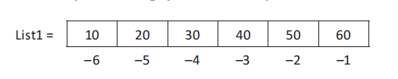
Python Structures - Lists :
Negative List Indices
The negative index accesses the elements from the end of a list counting in backward direction. The index of the last element of any non-empty list is always -1

Slide 49
Python Structures - Lists :
Negative List Indices
>>> List1=[10,20,30,40,50,60]#Create a List
>>> List1[-1] #Access Last element of a List
60
>>>List1[-2] #Access the second last element of List
50
>>> List1[-3] #Access the Third last element of List
40
>>>List1[-6] #Access the first Element of the List
10

Slide 50
Python Structures - Lists :
The pop() Method
The syntax of the pop() method is:
It removes an element from the List; however, it differs from the remove() method in two ways:
• It takes an index which is the index of the item to remove from the list rather than the object itself.
• The method returns the item that was removed as its result.
list6 = ['Once', 'Upon', 'a', 'Time']
print(list6)
print(list6.pop(2))
print(list6)
Output :
['Once', 'Upon', 'a', 'Time']
a
['Once', 'Upon', 'Time']

Slide 51
Python Structures - Lists :
The pop() Method
An overload of this method is just
<list>.pop()
Which removes the last item in the list. For example:
list6 = ['Once', 'Upon', 'a', 'Time']
print(list6)
print(list6.pop())
print(list6)
Output :
['Once', 'Upon', 'a', 'Time']
Time
['Once', 'Upon', 'a']

Slide 52
Python Structures - Lists :
Deleting from a List
The del keyword can be used to delete a single element or a slice from a list.
To delete an individual element from a list use del and access the element via its index:
my_list = ['A', 'B', 'C', 'D', 'E']
print(my_list)
del my_list[2]
print(my_list)
Output :
['A', 'B', 'C', 'D', 'E']
['A', 'B', 'D', 'E']

Slide 53
Python Structures - Lists :
Deleting from a List
To delete a slice from within a list use the del keyword and the slice returned from the list.
my_list = ['A', 'B', 'C', 'D', 'E']
print(my_list)
del my_list[1:3]
print(my_list)
Output :
['A', 'B', 'C', 'D', 'E']
['A', 'D', 'E']
<< Exercise B31 >>

Slide 54
Lists
List Slicing

Slide 55
Python Structures - Lists :
Lists - Examples
fib_list = [1, 1, 3, 5, 8]
We can update a list collection using methods like append():
fib_list.append(fib_list[-2] + fib_list[-1])
[1, 1, 3, 5, 8, 13]
In this example, the value of fib_list[-1] is the last element in the list, and fib_list[-2] is the penultimate value. The expression creates a new number, which can be appended to the fib_list object.
>>> fib_list[2]
3

Slide 56
Python Structures - Lists :
Lists - Examples
>>> my_pets = [" dog", "cat", " bird "]
>>> print my_pets [0]
dog
>>> print my_pets [ -1]
Bird
>>> my_pets = [" dog", "cat", " bird "] # a list
>>> print my_pets [0:2]
[’dog ’, ’cat ’]

Slide 57
Python Structures - Lists :
Lists - Examples
Remember that Python uses the half-open interval convention. The list goes up to but does not include the end index.
Indices start at 0. If you want to pull out the first item you reference it by 0, not 1. This is zero-based indexing.
You can also reference items using negative indices. -1 references the last item, -2 the second to last item, etc. This is especially useful for pulling off the last item.

Slide 58
Python Structures - Lists :
Lists - Examples
>>> print my_pets [:2]
[’dog ’, ’cat ’]
>>> my_pets [0: -1]
[’dog ’, ’cat ’]
>>> my_pets [: -1] # defaults to 0
[’dog ’, ’cat ’]
>>> my_pets [0: -2]
[’dog ’]
>>> my_pets [1:]
[’cat ’, ’bird ’]
>>> my_pets [ -2:]
[’cat ’, ’bird ’]
>>> print my\ _pets [:]
[’dog ’, ’cat ’, ’bird ’]

Slide 59
Python Structures - Lists :
Lists - Slicing
We can extract a sublist using slicing notation. A slicing uses a multi-part value in the []. The result of a slicing is always a list built from the original list object. :
>>> fib_list[2:5]
[3, 5, 8]
>>> fib_list[2:]
[3, 5, 8, 13]
>>> fib_list[:-1]
[1, 1, 3, 5, 8]
The first slicing, [2:5], starts at the index of 2 and stops just before the index of 5. This means that the index values of 2, 3, and 4 are sliced out of the original list.

Slide 60
Python Structures - Lists :
Lists - Slicing
The second slicing, [2:], omits the ending, which means that it starts at an index of 2 and includes all items to the end of the list.
The third slicing, [:-1], omits the starting position, which means that it starts at an index of 0. The ending is given as -1, the last item in the list. Since slicings stop short of the given final position, this slicing will omit the last item from the list.
We can use [:] as a degenerate case where the start and end are both omitted. This works very well when making a shallow copy of an entire list object.

Slide 61
Python Structures - Lists :
Lists – Striding Slices
Slicings can be extended to include a third parameter. This allows us to specify a start, stop, and a step value. We can do things like this:
>>> fib_list[::2]
[1, 3, 8]
>>> fib_list[1::2]
[1, 5, 13]
In the first example, the start and stop are omitted, so we'll use the entire list. The step value is 2, so we'll extract a new list using the even-numbered indexes: 0, 2, 4, …, and so on.

Slide 62
Python Structures - Indexing & Slicing :
Striding Slice
Slices can also take a stride following the starting and ending indices. The default value for a stride when unspecified is 1, which means to take every item from a sequence between the indices. A stride of 2 would take every second item. A stride of 3 would take every third item:
>>> my_pets = [" dog", "cat", " bird "]
>>> dog_and_bird = my_pets [0:3:2]
>>> print dog_and_bird
[’dog ’, ’bird ’]
>>> zero_three_six = [0, 1, 2, 3, 4, 5, 6][::3]
>>> print zero_three_six
[0, 3, 6]

Slide 63
Python Structures - Indexing & Slicing :
Striding Slice
Strides can be negative. A stride of -1 means that you move backwards right to left. If you want to use a negative stride, you should make the start slice greater than the end slice. The exception for this is if you leave out the start and end indices a stride of -1 will reverse the sequence:
>>> my_pets [0:2: -1]
[]
>>> my_pets [2:0: -1]
[’bird ’, ’cat ’]
>>> print [1, 2, 3, 4][:: -1]
[4, 3, 2, 1]

Slide 64
Python Structures - Lists :
Lists – Slicing (Examples)
>>> L1=([10,20,30,40,50]) #a List with 5 Different Elements
>>> L1[1:4]
20,30,40
>>> L1=([10,20,30,40,50]) #List with 5 Different Elements
>>> L1[2:5]
[30, 40, 50]
>>>MyList1=[“Hello”,1,”Monkey”,2,”Dog”,3,”Donkey”]
>>>New_List1=MyList1[0:6:2]
print(New_List1)
[‘Hello’, ‘Monkey’, ‘Dog’]

Slide 65
Python Structures - Lists :
Lists - Slicing
>>> List1=[“Python”,450,”C”,300,”,C++”,670]
>>> List1[0:6:3] #Start from Zero,Select every Third Element
[‘Python’, 300] #Output
some more complex examples of List slicing
>>> List1=[1,2,3,4] #List With Four Elements
>>> MyList1[:2] #Access first two elements of the List.
[1,2]
>>> MyList1[::-1] #Display List in Reverse Order
[4, 3, 2, 1]

Slide 66
Python Structures - Indexing & Slicing :
Slicing sub lists
If you include the colon (:), the first and second indices are optional. If both indices are missing, the slice returned will contain a copy of the list. This is actually a construct you see to quickly copy lists in Python.
>>> print my\ _pets [:]
[’dog ’, ’cat ’, ’bird ’]

Slide 67
Python Structures - Lists :
Lists - Slicing
#Start index with -1 and End Index with 0 and step Size with -1
>>>MyList1[-1:0:-1]
[4, 3, 2]
>>> my_pets [0:2: -1]
[]
>>> my_pets [2:0: -1]
[’bird ’, ’cat ’]
>>> print [1, 2, 3, 4][:: -1]
[4, 3, 2, 1]

Slide 68
Python Structures - Lists :
Lists - Slicing
>>> 13 in fib_list
True
>>> 12 not in fib_list
True

Slide 69
Lists
Python Built-in Functions for Lists

Slide 70
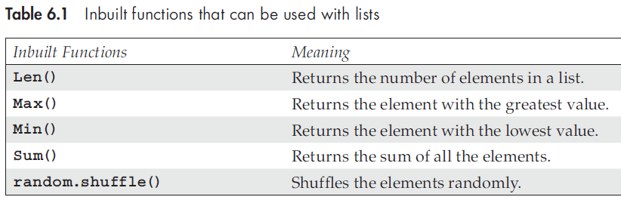
Python Structures - Lists :
Python Built-in Functions for Lists
>>> List1=[“Red”,”Orange”,”Pink”,”Green”]
>>> List1
[‘Red’, ‘Orange’, ‘Pink’, ‘Green’]
>>> len(List1) #Returns the Size of List
4

Slide 71
Python Structures - Lists :
Python Built-in Functions for Lists
#Create a List, find the Greatest and Minimum value from the list.
>>> List2=[10,20,30,50,60]
>>> List2
[10, 20, 30, 50, 60]
>>> max(List2) #Returns the greatest element from the list.
60
>>> min(List2) #Returns the minimum element from the list.
10

Slide 72
Python Structures - Lists :
Python Built-in Functions for Lists
#Create a List, and Shuffle the elements in random manner. Test Case 1
>>>import random
>>> random.shuffle(List2)
>>> List2
[30, 10, 20, 50, 60]
>>> List2
[30, 10, 20, 50, 60]

Slide 73
Python Structures - Lists :
Python Built-in Functions for Lists
#Test Case2
>>> random.shuffle(List2)
>>> List2
[20, 10, 30, 50, 60]
#Create a List, and find the sum of all the elements of a List.
>>> List2=[10,20,30,50,60]
>>> List2
[10, 20, 30, 50, 60]
>>> sum(List2) # Returns the sum of all the elements
170

Slide 74
Lists
List Operator

Slide 75
Python Structures - Lists :
The List Operator
1. The + Operator: The concatenation operator is used to join two lists.
>>> a=[1,2,3] #Create a list with three elements 1,2, and 3
>>> a #Prints the list
[1, 2, 3]
>>> b=[4,5,6] #Create a list with three elements 4,5, and 6
>>> b #print the list
[4, 5, 6]
>>> a+b #Concatenate the list a and b
[1, 2, 3, 4, 5, 6]

Slide 76
Python Structures - Lists :
The List Operator
2. The * Operator: The multiplication operator is used to replicate the elements of a list.
>>> List1=[10,20]
>>> List1
[10, 20]
>>> List2=[20,30]
>>> List2
[20, 30]
>>> List3=2*List1 #Print each element of a List1 twice.
>>> List3
[10, 20, 10, 20]

Slide 77
Python Structures - Lists :
The List Operator
3. The in Operator: The in operator used to determine whether an element is in a list. It returns True if the element is present and False if the element is absent in the list.
>>> List1= [10,20]
>>> List1
[10, 20]
>>> 40 in List1 #To Check if 40 is present in List1
False
>>> 10 in List1 #To Check if 10 is present in List1
True

Slide 78
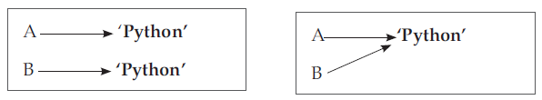
Python Structures - Lists :
The List Operator
4. The isOperator: Let us execute the following two statements:
A=’Python’
B=’Python’
We know that both A and B refer to a string but we don’t know whether they refer to the same string or not. Two possible situations are:

Slide 79
Python Structures - Lists :
The List Operator
In the first case, A and B refer to two different objects that have the same values. In second case, they refer to the same object. To understand whether two variables refer to the same object, a programmer can use the ‘is’ operator.
>>> A=’Microsoft’
>>> B=’Microsoft’
>>> A is B #Check if two variable refer to the same Object
True
From the above example, it is clear that Python created only one string object and both A and B refer to the same object. However, when we create two lists with the same elements, Python creates two different objects as well.

Slide 80
Python Structures - Lists :
The List Operator
>>> A=[‘A’,’B’,’C’]
>>> B=[‘A’,’B’,’C’]
>>> A is B #Check if two lists refer to the same Object
False
Explanation In the above example, the two lists A and B contain exactly the same number of elements. The is operator is used to check if both the variables A and B refer to the same object, but it returns False. It means that even if the two lists are the same, Python creates two different objects..

Slide 81
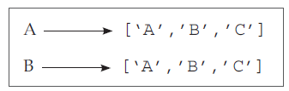
Python Structures - Lists :
The List Operator
It is important to note that in the above example, we can say that the two lists are equivalent because they have the same elements. We cannot say that both the lists are identical because they don’t refer to the same object.

Slide 82
Python Structures - Lists :
The List Operator
5. The del Operator: The del operator stands for Delete. The del operator is used to remove the elements from a list. To delete the element of a list, the elements of the list are accessed using their index position and the del operator is placed before them.
Lst=[10,20,30,40,50,60,70]
>>> del Lst[2] #Removes 3rd element from the List
>>> Lst
[10, 20, 40, 50, 60, 70]

Slide 83
Python Structures - Lists :
The List Operator
Lst=[10,20,30,40,50,60,70]
>>> del Lst[-1]
>>> Lst #Removes last element from the List
[10, 20, 30, 40, 50, 60]
>>> Lst=[10,20,30,40,50,60,70]
>>> del Lst[2:5] #Removes element from index position 2 to 4
>>> Lst
[10, 20, 60, 70]

Slide 84
Python Structures - Lists :
The List Operator
>>> Lst=[10,20,30,40,50,60,70]
>>> del Lst[:] #Removes all the element from the List
>>> Lst
[]
Note: The del operator uses index to access the elements of a list. It gives a run time error if the index is out of range.
>>> del Lst[4]
Traceback (most recent call last):
File “<pyshell#37>”, line 1, in <module>
del Lst[4]
IndexError: list assignment index out of range

Slide 85
Lists
List Comprehensions

Slide 86
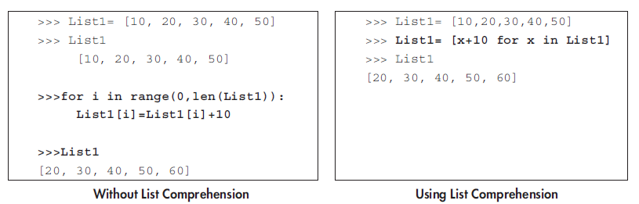
Python Structures - Lists :
List Comprehensions
List comprehension is used to create a new list from existing sequences. It is a tool for transforming a given list into another list.

Slide 87
Python Structures - Lists :
List Comprehensions
The output for both without list comprehension and using list comprehension is the same. The use of list comprehension requires lesser code and also runs faster. With reference to the above example we can say that list comprehension contains:
a. An input sequence
b. A variable referencing the input sequence
c. An optional expression
d. An output expression or output variable

Slide 88
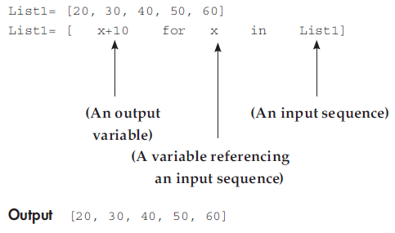
Python Structures - Lists :
List Comprehensions
xxx

Slide 89
Lists
Lists and Strings

Slide 90
Python Structures – Lists and Strings :
Lists and Strings
A String is a sequence of characters and list is sequence of values, but a list of characters is not the same as string. To convert from string to a list of character, you can use list.
Example: Convert String to list of Characters
>>> p=’Python’
>>> p
‘Python’
>>> L=list(p)
>>> L
[‘p’, ‘y’, ‘t’, ‘h’, ‘o’, ‘n’]
Note : The list() function breaks a string into individual letters.

Slide 91
Python Structures – Lists and Strings :
Splitting a string in List
>>> A=”Wow!!! I Love Python Programming” #A String
>>> B=A.split() # Split a String into Words
>>> B #Print the contents of B
[‘Wow!!!’, ‘I’, ‘Love’, ‘Python’, ‘Programming’]
Explanation In the above example, we have initialized string to A as “Wow!!! I Love Python Programming”. In the next line, the statement, B = A.split() is used to split “Wow!!! I Love Python Programming” into the list [‘Wow!!!’, ‘I’, ‘Love’, ‘Python’, ‘Programming’].
Notes:
Note: In the above program, we have used the following two lines to split string into words:
>>> A=”Wow!!! I Love Python Programming”
>>> B=A.split()
We can also write the split method as
>>> A=”Wow!!! I Love Python Programming”.split()

Slide 92
Python Structures – Lists and Strings :
Lists and Strings
A string containing a delimiter can be split into words by removing the delimiter. The following example illustrates the use of a delimiter inside the split() method.
>>> P=”My-Data-of-Birth-03-June-1991” # String with Delimiter ‘-‘
>>> P # Print the Entire String
‘My-Date-of-Birth-03-June-1991’
>>> P.split(‘-’) #Remove the delimiter ‘–‘ using split method.
[‘My’, ‘Date’, ‘of’, ‘Birth’, ‘03’, ‘June’, ‘1991’]

Slide 93
Lists
Aliasing and Side Effects

Slide 94
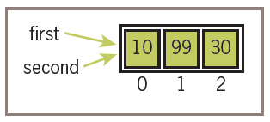
Lists - Aliasing and Side Effects :
Aliasing
Lists are mutable.
>>> first = [10, 20, 30]
>>> second = first
>>> first
[10, 20, 30]
>>> second
[10, 20, 30]
>>> first[1] = 99
>>> first
[10, 99, 30]
>>> second
[10, 99, 30]
the assignment second = first, the variables first and
Second refer to the exact same list object.

Slide 95
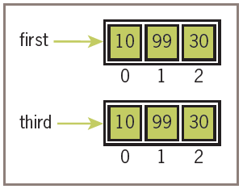
Lists - Aliasing and Side Effects :
Aliasing
>>> third = []
>>> for element in first:
third.append(element)
>>> first
[10, 99, 30]
>>> third
[10, 99, 30]
>>> first[l] = 100
>>> first
[10, 100, 30]
>>> third
[10, 99, 30]
Notes:
A simpler way to copy a list is to pass the source list to a call of the list function, as follows:
>>> third = list(first)

Slide 96
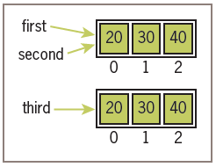
Lists - Aliasing and Side Effects :
Aliasing
Python’s is operator can be used to test for object identity. It returns True if the two operands refer to the exact same object, and it returns False if the operands refer to distinct objects (even if they are structurally equivalent).
>>> first = [20, 30, 40]
>>> second = first
>>> third = list(first) # Or first[:]
>>> first == second
True
>>> first == third
True
>>> first is second
True
>>> first is third
False

Slide 97
Lists
Passing List to a Functions

Slide 98
Python Structures – Passing List to a Function :
Lists and Strings
Create a list of 5 elements. Pass the list to a function and print the contents of the list inside the function.
def Print_List(Lst):
for num in Lst:
print(num,end=‘’)
Lst=[10,20,30,40,100]
Print_List(Lst) # Invoke Function by Passing List as Parameter
Output :
10 20 30 40 100

Slide 99
Python Structures – Passing List to a Function :
Lists and Strings
Create a list of five elements. Pass the list to a function and compute the average of five numbers.
def Calculate_Avg(Lst):
print(‘Lst= ‘,Lst)
print(‘ Sum = ‘,sum(Lst))
avg=sum(Lst)/len(Lst)
print(‘ Average = ‘,avg)
Lst=[10,20,30,40,3]
Calculate_Avg(Lst)
Output :
Lst= [10, 20, 30, 40, 3]
Sum = 103
Average = 20.6

Slide 100
Python Structures – Passing List to a Function :
Returning List from a Function
We can pass a list while invoking a function. Similarly, a function can return a list. When a function returns a list, the list’s reference value is returned. After passing, reverse the elements of the list and return the list.

Slide 101
Python Structures – Passing List to a Function :
Returning List from a Function
Program 6.8 Write a program to pass a list to function
def Reverse_List(Lst):
    print(‘List Before Reversing = ‘,Lst)
    Lst.reverse() # The reverse() to reverse the contents of list
    return Lst # Return List
Lst=[10,20,30,40,3]
print(‘List after Reversing = ‘,Reverse_List(Lst))
Output :
List Before Reversing = [10, 20, 30, 40, 3]
List after Reversing = [3, 40, 30, 20, 10]

Slide 102
Python Structures – Lists and Strings :
Returning List from a Function
PrOgram 6.9 Write a function that accepts a positive integer k and returns a list that contains the first five multiples of k. The first five multiples of 3 are 3, 6, 9, 12, and 15.
def list_of_multiples(k):
my_list=[]
for i in range(1,6):
res=k*i
my_list.append(res)
return my_list
print(list_of_multiples(3))
Output :
[3, 6, 9, 12, 15]

Slide 103
Python Structures - Lists :
Using collection functions
>>> some_set = {7, 2, 3, 5}
>>> sorted(some_set)
[2, 3, 5, 7]
>>> max(some_set)
7
>>> min(some_set)
2
>>> sum(some_set)
17

Slide 104
Python Structures - Lists :
Matrices as Nested Lists
Most of the data we store in the real world is in the form of a tabular data table, that is, rows and columns, instead of a one-dimensional flat list. Such tables are called matrices or two-dimensional arrays. Python (and most other programming languages) does not provide a table structure out of the box.
Programming languages do not provide table structures as it is not the role of a language to do so. A table structure is simply a way to present data.
What you can do is to present the table structure shown in Figure 2.3 using a list of lists; for example, if you want to store the following fruit orders using a list:

Slide 105


Python Structures - Lists :
Matrices as Nested Lists
Figure 2.3: A representation of lists of lists as a matrix
Mathematically, you can present the information shown in figure 2.3 using a 2 x 3 (2 rows by 3 columns) matrix. This matrix would look like this:
Figure 2.4: A matrix representation of data
Now you will see how you can store this matrix as a nested list in the following exercise.
<< Exercise A22 >>

Slide 106


Python Structures - Lists :
Matrix Operations
Use nested lists for some basic matrix operations…first, you look at how to add two matrices in Python. Matrix addition requires both matrices to have the same dimensions; the results will also be of the same dimensions.
Figure 2.7: Matrix data for matrix X
Figure 2.8: Matrix data for matrix Y
<< Exercise A23 >>

Slide 107


Python Structures - Lists :
Matrix Multiplication Operations
You can look at how to use nested lists to perform matrix multiplication for the two matrices shown in figures 2.9 and 2.10:
Figure 2.9: The data of matrix X
Figure 2.10: The data of matrix Y

Slide 108
Python Structures - Lists :
Matrix Multiplication Operations
For a matrix multiplication operation, the number of columns in the first matrix (X) must be equal the number of rows in the second matrix (Y). The result will have the same number of rows as the first matrix and the same number of columns as the second matrix. In this case, the result matrix will be a 3 x 4 matrix.
<< Exercise A24 >>

Slide 109
Python Structures - Lists :
Online Resources
See the Python Standard Library documentation for:
• https://docs.python.org/3/tutorial/datastructures.html Python Tutorial on data structures.
• https://docs.python.org/3/library/stdtypes.html#sequence-types-list-tuple-range for lists and tuples.
• https://docs.python.org/3/tutorial/datastructures.html#tuples-and-sequences the online tuples tutorial.
• https://docs.python.org/3/tutorial/datastructures.html#lists the online List tutorial.

Slide 110
Thank you

